Slide 1
ENSE 374, Milestone 1
Group 07
Jacob Chapman, William Peers, Jingkang yang
October 2nd, 2019

Slide 2
Team introduction: We are group 07!
GitHub URL:
  https://github.com/Jacobchapman99/ENSE-374-Group07-Project.git

Slide 3
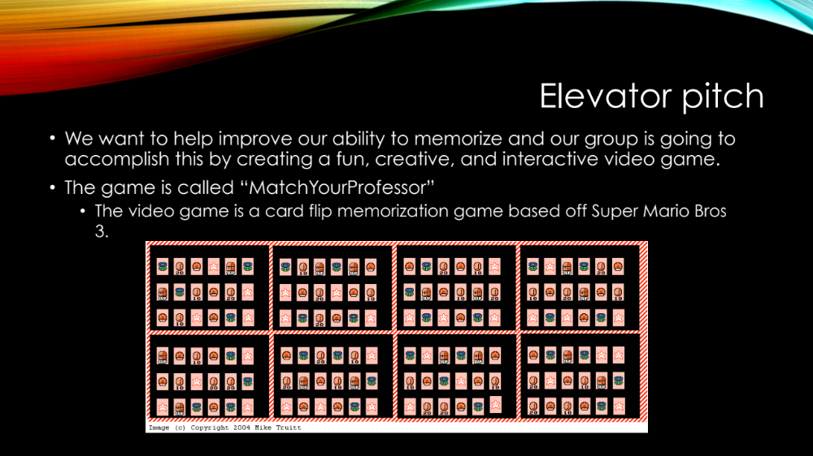
Elevator pitch
We want to help improve our ability to memorize and our group is going to accomplish this by creating a fun, creative, and interactive video game.
The game is called “MatchYourProfessor”
  The video game is a card flip memorization game based off Super Mario Bros 3.

Slide 4
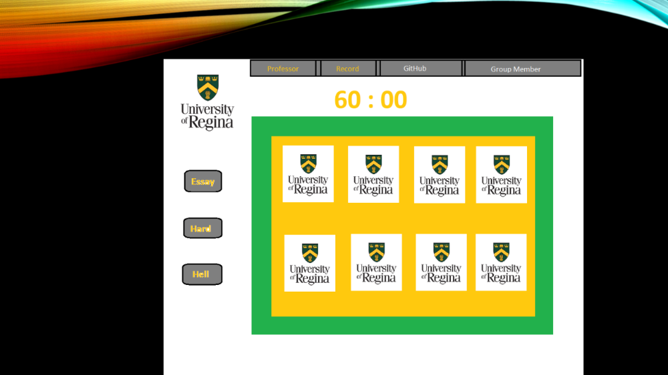


Slide 5
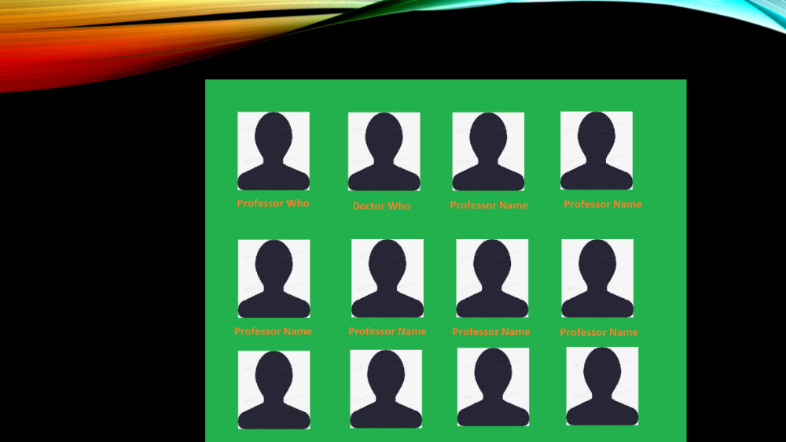

Slide 6
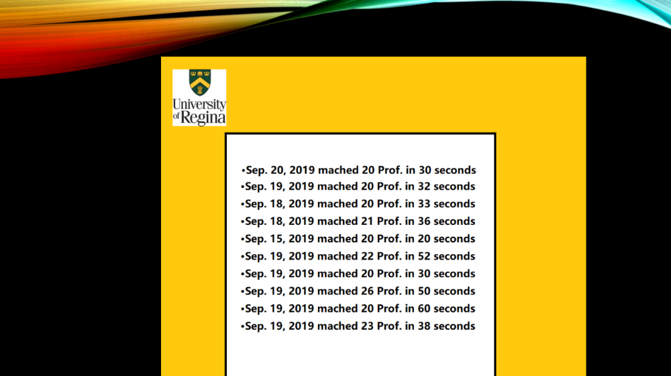

Slide 7
Initial System & Functional Requirements
What exactly are we doing?
  Building an interactive website for users to help build their memorization skills
Possible Constraints:
  Lack of web development experience
  Only 3 group members
Our vision:
  To help users stimulate their brain activity and to have fun
Envisioned Stakeholders:
  The class
  Other uni students

Slide 8
Initial Kanban
Kanban link: https://github.com/Jacobchapman99/ENSE-374-Group07-Project/projects
Our Kanban categories:
  Backlog -> User stories, archives, etc
  To Do -> Project tasks soon to be in progress
  Progress -> Who’s doing what (Miscellaneous tasks)
  Done -> completed tasks
  Development -> current developments being made on the website, database integration, coding, etc
  Testing -> When a development is done, it will be in the testing phase
  Production -> the “Done” phase, where a function is ready for clients to use and operate

Slide 9
GitHub
Github Link: https://github.com/Jacobchapman99/ENSE-374-Group07-Project
Our File Structure:
  Milestones
  Organization -> attendance sheet, ideas, etc..
  Website Sketches
  Website Interface
  Website Source Code

Slide 10
Group reflection
How did you feel about this milestone? What did you like about it? What did you dislike?
  We felt that this milestone was good as it let us explore what kind of project we want to work on, and it let us learn about our team members. We disliked that since were all busy with courses it was hard to meet up
What did you learn about yourself as you collaborated and worked through this milestone?
  [I learned that while working together as a team, there are many methods to choose from]
How will you use what you have learned going forward?
  [All the information we have learnt in class regarding methods to team success, MVC knowledge, project ideas will all be used to successfully produce a complete product]

